Slide 1



Institute of Emerging Careers
CAPSTONE PROJECT
PRESENTATION
77
Presented by
Guided by
Muhammad Hussain
Muhammad Hamza

Slide 2
Online Sale in USA

Slide 3
Table of Content
Introduction
Exploratory Data Analysis
Correlation
Overall Sales Trend (Month over Month)
Customer Analysis
Recency -Frequency-Monetary Analysis (RFM)
Customer Life Time Value (LTV)
Recommendations
R File Code Here

Slide 4
Data Attributes
Order id: it contains the id of the orders placed
Order date: it consist of ordered date
Status: It contain the order info. like order delivered or received or cancelled
Item id: it consist of item ids
quantity ordered: the number of items ordered
price : the unit price of the item
Discount amount: contains discount amount given
Category: consist of items category like appliances ,fashions, mobiles, etc.
Customer Since: the date at which customer is with your organization
Phone No. the phone number of the customer

Slide 5
Data Attributes
Payment method: it contain info.about the medium used to pay
the price
Cust id: contain the unique customer id
Year: the year in which the order placed
Month: the month of order
First Name: customer name
Middle Initial: customer name
Last Name: customer name
Gender: either male or female
Age: the age of the customer
Place Name: the area where customer belong
City: the city of customer
Region: the region where the customer is
Discount Percent: the percentage of discount amount

Slide 6

Dataset Summary
It contains one year data about the online sales of different products, several merchandise and electronic in different states.
Since a huge chunk of the people are switching to online shopping, large retailers are actively searching for ways to increase their profit.
Sales analysis is one such key techniques to increase sales by understanding the customers' purchasing behavior & patterns.

Slide 7

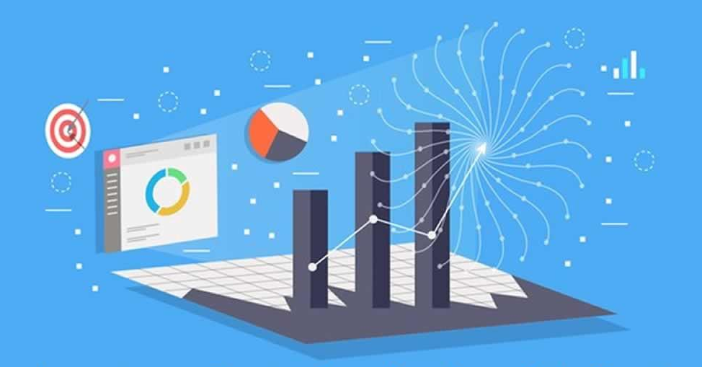
Exploratory Data Analysis
It is an approach of analyzing data to summarize their main characteristics, often using statistical graphics and other data visualization methods.
‹#›

Slide 8
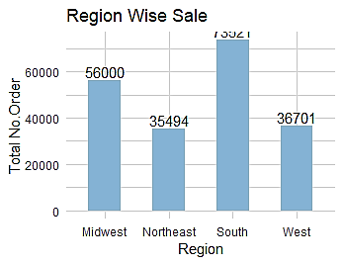
Region Wise Total No of Orders

Slide 9
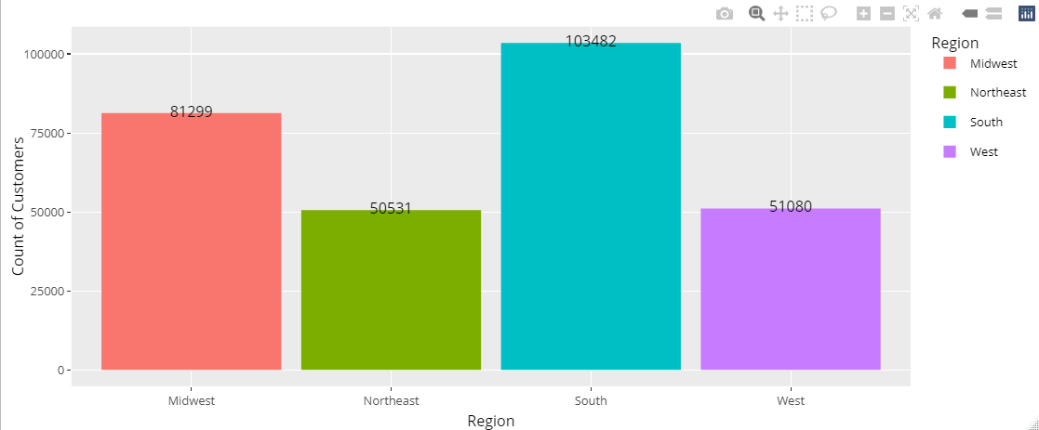
Customers Distribution Across the Different Regions

Slide 10
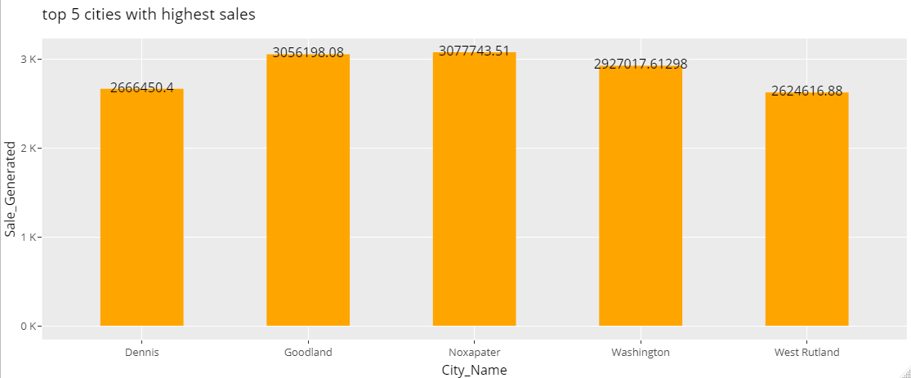
Top 5 Cities With Highest Sale Generated

Slide 11
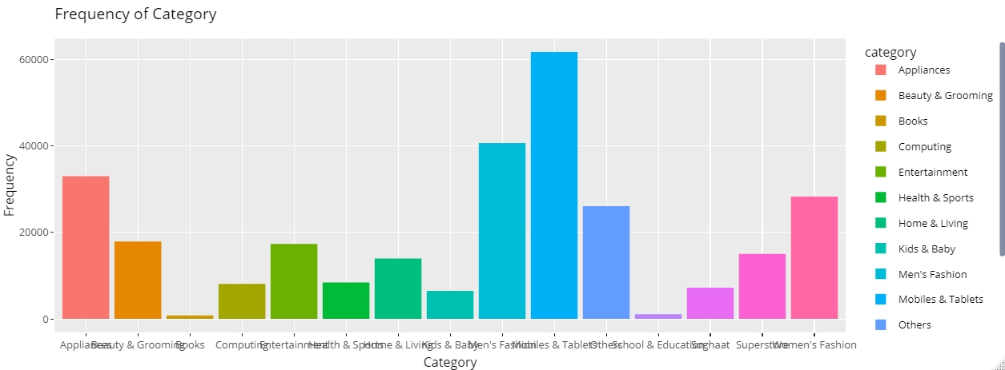
Frequency of Different Categories
‹#›

Slide 12
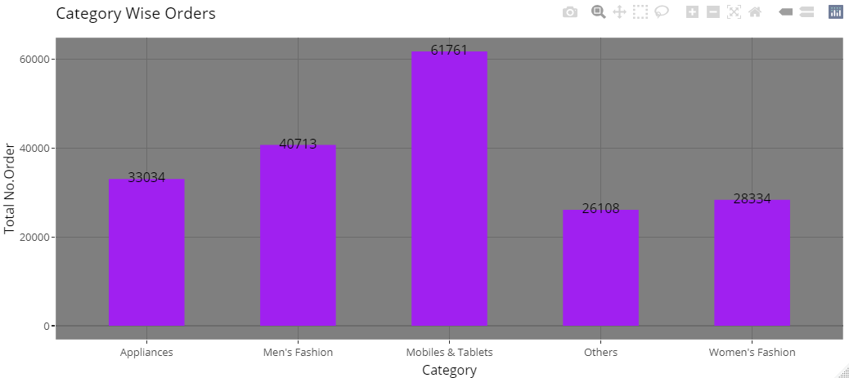
Top 5 Category Depending on No. of Orders

Slide 13
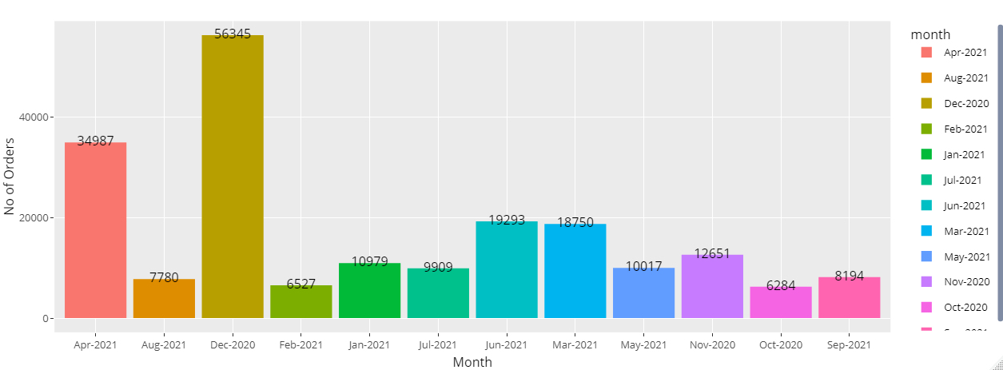
Which Month has Highest No of Orders?

Slide 14
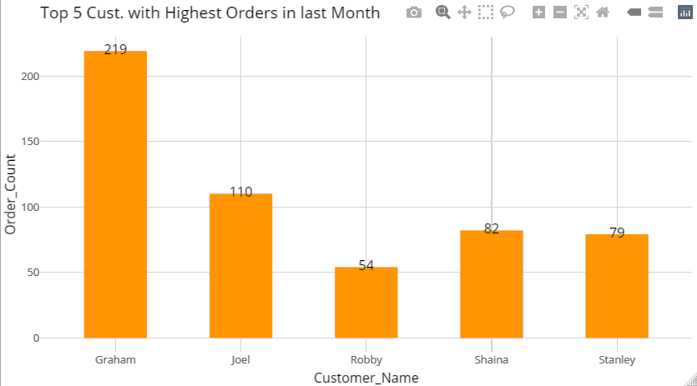
Top 5 Customers with Highest Orders in last Month

Slide 15
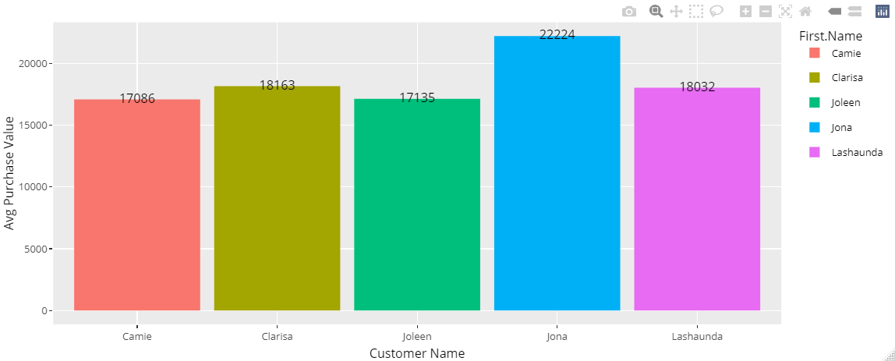
Top Customers who have highest Avg purchase value per order

Slide 16
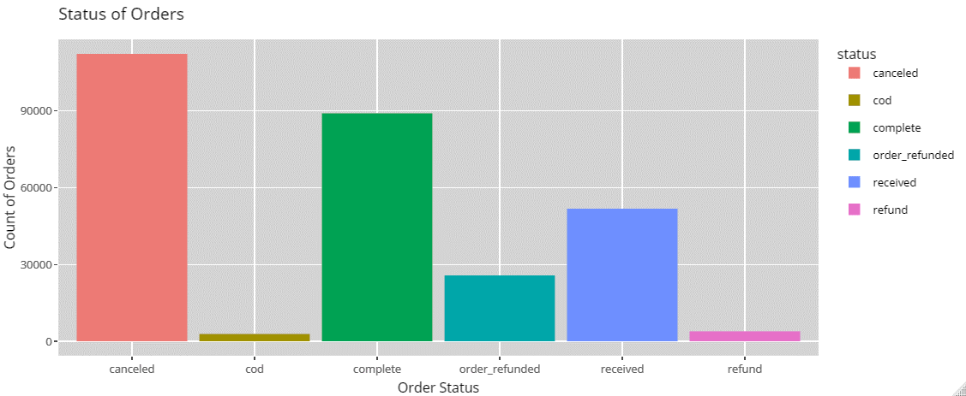
Status of Most of the Orders?

Slide 17
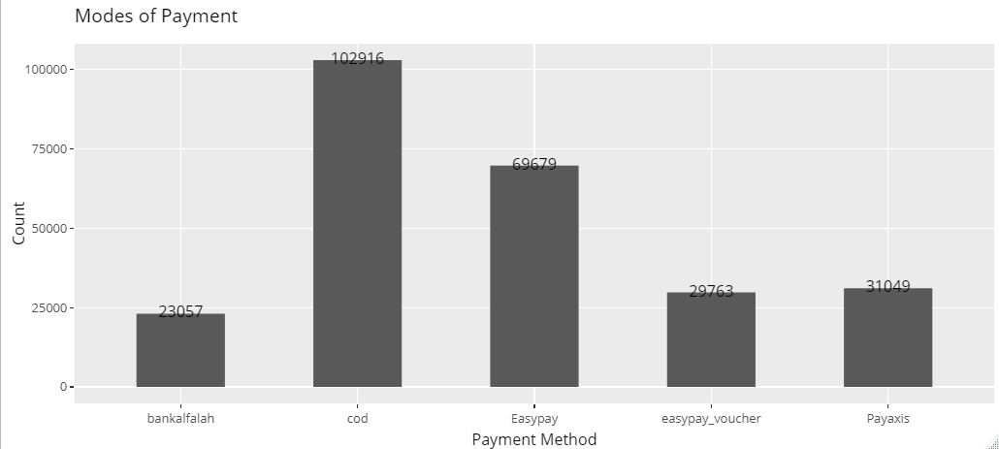
Most Preferred Mode of Payment?

Slide 18
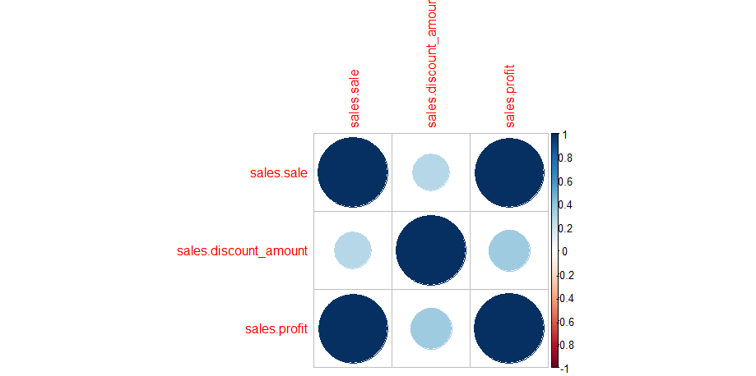
Correlation
Correlation shows how two variables move in relation to one another.

Slide 19

Overall Sale Trend

Slide 20
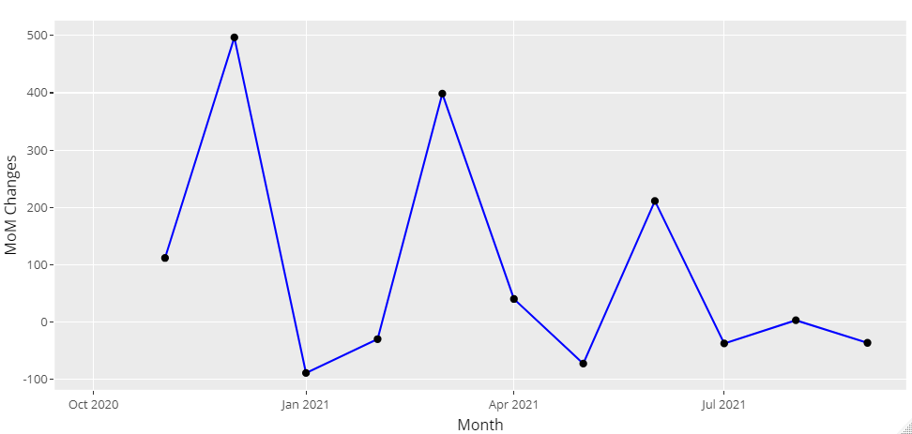
Month Over Month Comparison of Sales Trend

Slide 21

Customer Analysis
Monthly Active Customers
Monthly Retained Customer
Monthly churned customer

Slide 22
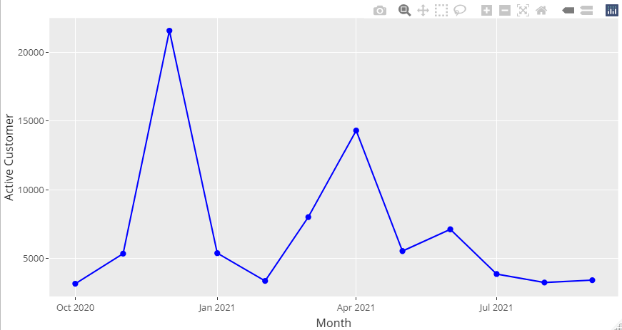
Monthly Active Customers
It is a metric used to identify the number of unique customers who engage with their
business within last month

Slide 23

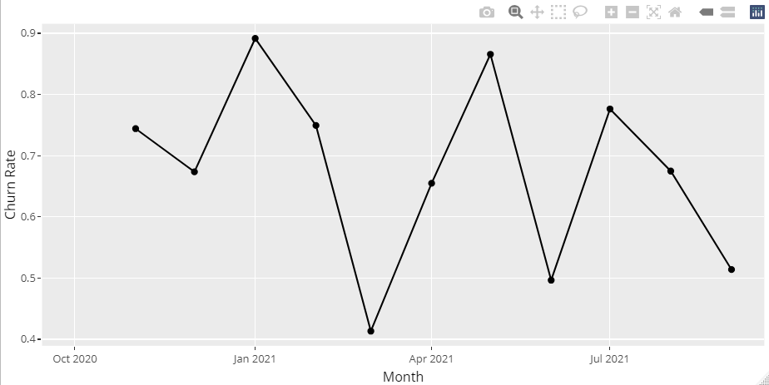
Churn Rate
Rate at which a customer stop doing business in period of time. It refers to count of customers a business loses within period
of time.
Cust at the beg. of period - Cust at the end of period
Cust at the end of period
Churn Rate
=
Reason Why Customer Churn
Your customers no longer see the value in ur product
poor customer experience.
Your users aren’t engaged enough
Customer needs are changed

Slide 24
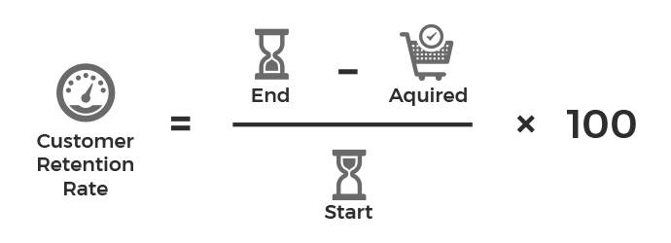
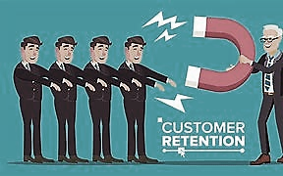
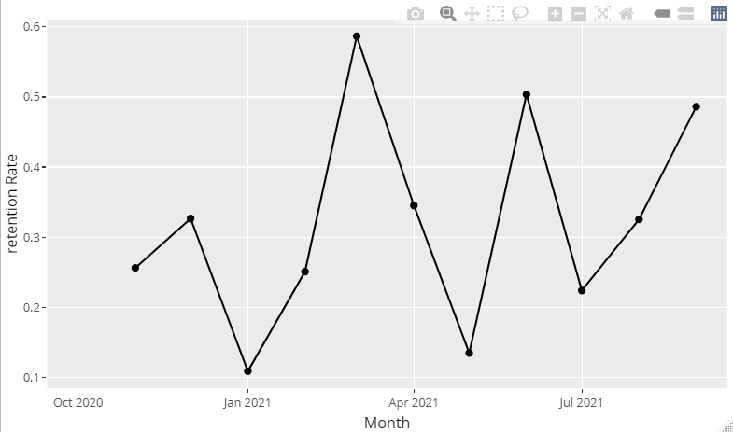
Retention Rate
A percentage of customers’ business retains over a period of time. A high retention rate logically shows that a business has a
low churn rate which is the best thing for business.
Advantage of Retention Rate
Deeper connections among staff
Reducing the cost of customer acquisition
Building referrals and loyalty
Support sustainable company growth

Slide 25
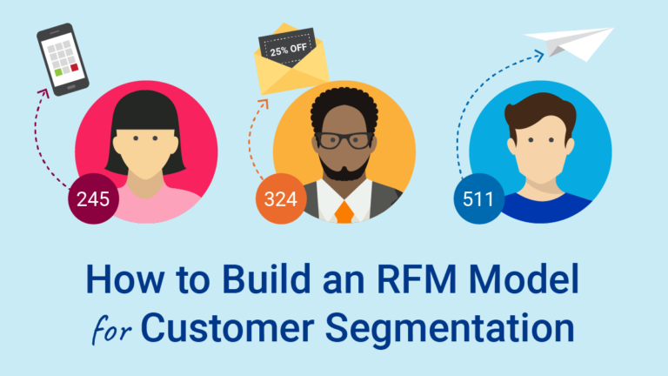
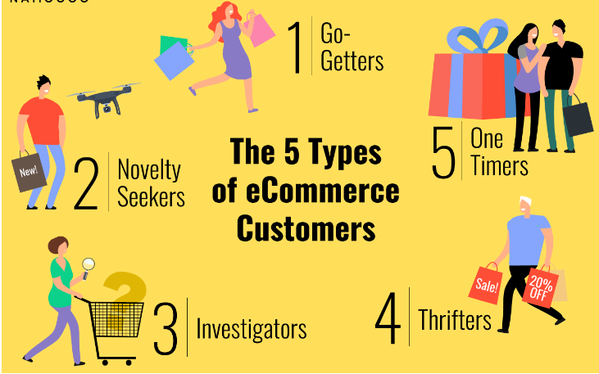
Different Type of Customers Online

Slide 26
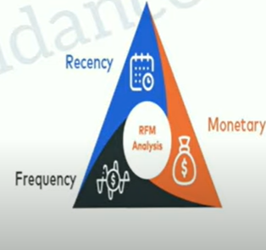
RFM Analysis
It is a market analysis tool used to identify a company’s best customers by measuring and analyzing their spending habits.
‹#›

Slide 27
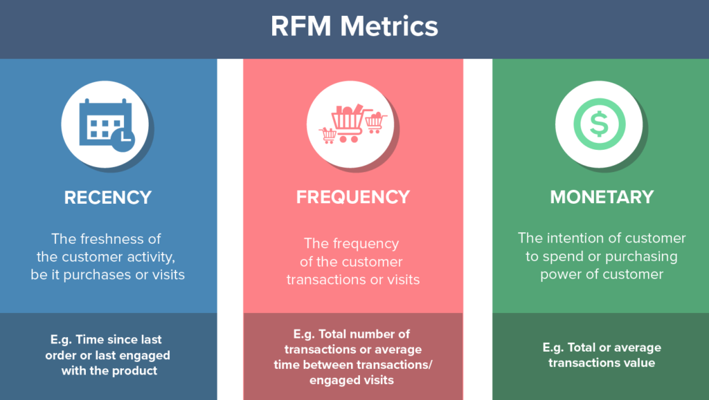
Recency-Frequency-Monetary(RFM)
Recency
It is calculated by taking the most recent date that the customer has made a purchase.
Frequency
Number of transactions performed by every customer.
Monetary
Total money spent by every customer in the store.

Slide 28
RFM= RECENCY & FREQUENCY & MONETARY
RFM Scoring
RFM scores are calculated to know the purchase behavior of any customer.
Each customer is ranked in each of these categories generally on scales of 1 to 5 (the higher the number the better the result)
The higher the rank the more likely they will do business again
1 is the least important.
3 is the intermediate
5 is the most important one.

Slide 29
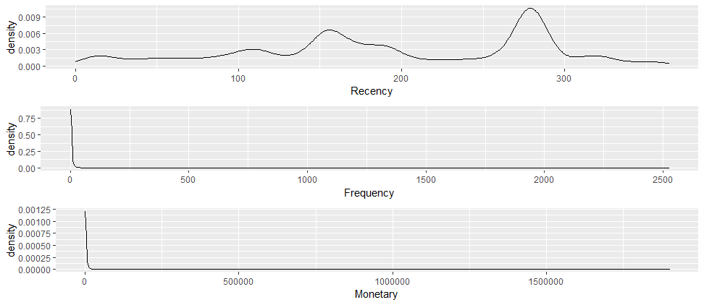
Distribution of the RFM quantities
In the below plot, we can see that the 2 quantities have a skewed data distribution. The peak of frequency and monetary values is very close to 0, whereas peak of recency is around 280.

Slide 30
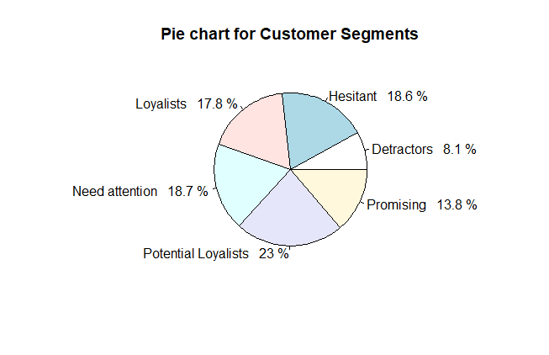
Pie chart for Customer Segments
Loyalist
potential loyalist
Promising
Hesitant
Need Attention
Detractors

Slide 31
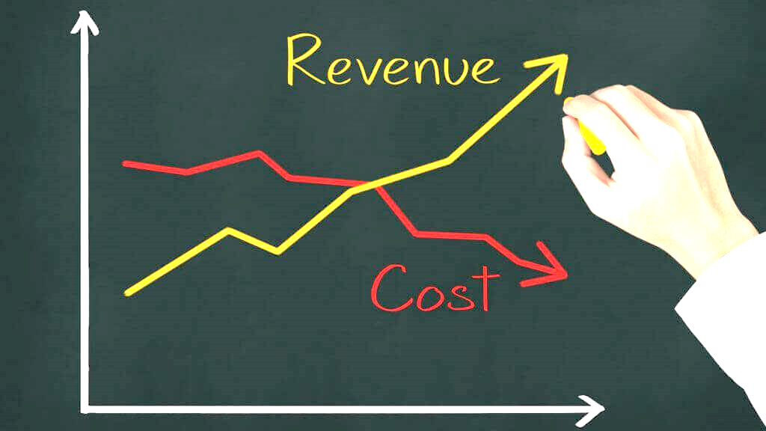
Benefits of RFM Analyses
Increase your revenue by targeting specific segments
Bring back old customers
Increase your customer lifetime value (LTV)
Tell you about churned customers

Slide 32
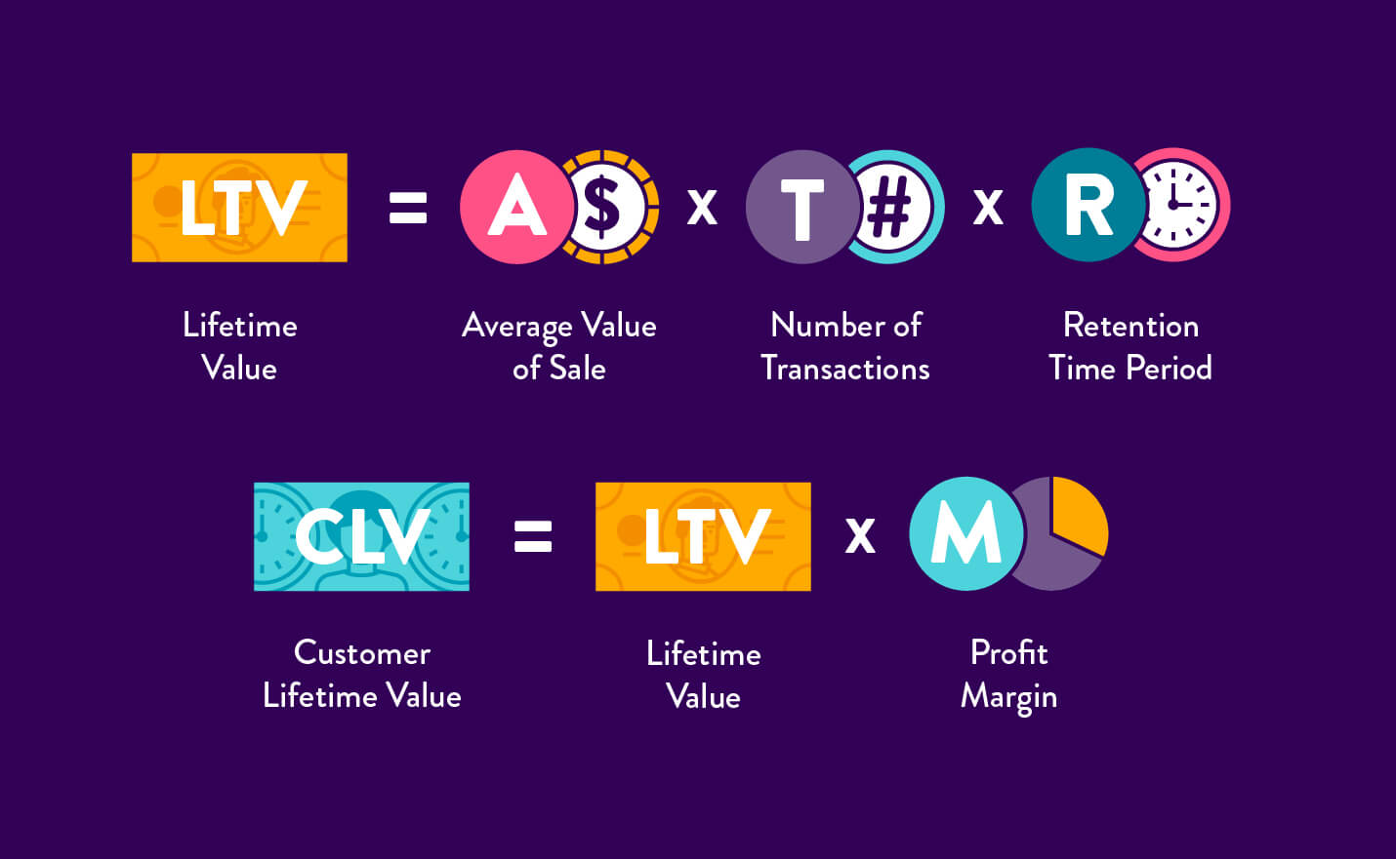
Customer Life Time Value
It is a metric that indicates the total revenue a business can reasonably expect from a single customer account throughout the business relationship.
Importance of calculating LTV
Keep close tabs on your social media channels.
Personalize the customer experience
Implement a loyalty or rewards program
Improving Audience Targeting
Identifying Points of Frustration

Slide 33
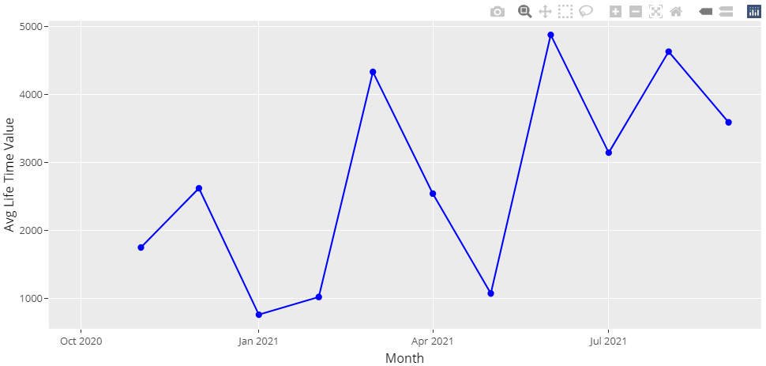
Average LTV

Slide 34
Recommendations
Our most of the orders are cancelled due to some reasons which we can see in EDA. Company has to find out that what is the reason behind it. Otherwise in less time company orders will be dead.
Secondly I suggest that company should work on Customers who Need Attention because in RFM analysis, we came to know that 18% of customers are those who Need Attention. If some strategies are not implemented to them, chances are that they will become detractors in less time.
Also we know that most of the times our churn rate is very high compare to retention rate and that is the dangerous sign to loss of revenue because more customers are leaving your business means more Cost of Acquisition of customer needed to get new customers to your business.

Slide 35
R_Script File
Click here To get Code

Slide 36


